Slide 1
LONDON TRIP 2024 Monday 15th July – Wednesday 17th July

Slide 2
Staff
Ms Naylor Mrs Banks Mrs Lewis Miss Morgan

Slide 3
What to Wear
Tracksuit bottoms
School hoodie
T- shirt
Trainers or walking style boots
Needs to be practical and as we are representing school, appropriate

Slide 4
What to pack….
Monday - Lunch and snacks to have in a plastic bag that can all be thrown away
Water Bottle (full) - no energy drinks or cans
Any snacks for the Tuesday / Wednesday if you wish (school will provide)
School will provide toiletries
Pyjamas
Hair brush
2x Underwear
Clothes for Tuesday and Wednesday
Sun cream / hat / sunglasses
Rain coat
Medication (Adult distributed medication to be given to office prior)
A rucksack / backpack is imperative as wheelie suitcases are not able to be stored at the museum.

Slide 5
What to pack….
NO DEVICES ALLOWED
We will update parents about the trip by text and Facebook
We will only contact you if needed

Slide 6
The Itinerary- Day 1 - MONDAY

Slide 7
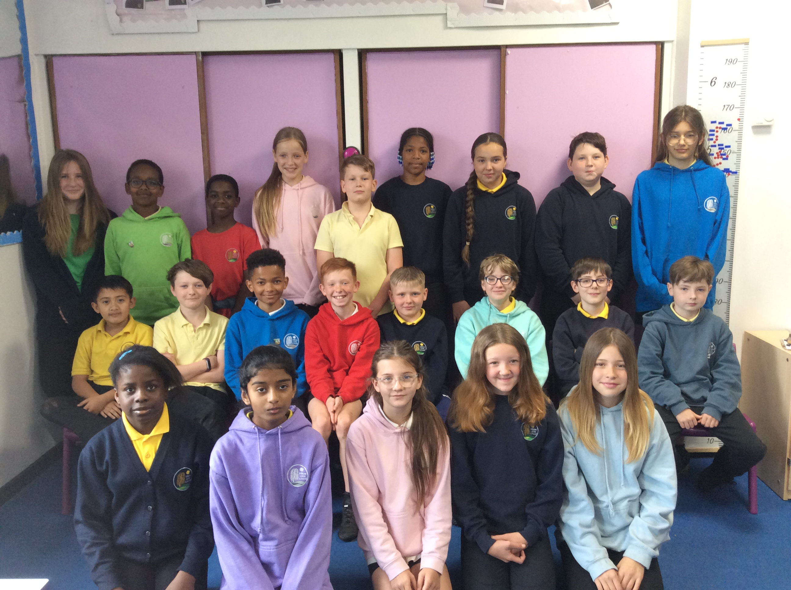
Slide 27
Meet at school at 9am promptly
Hand over medication

Slide 8
Slide 27
9:40am- Train to Euston
Children will be sat in pairs on carriage.
Can play cards/ read a book
Can have a snack and drink

Slide 9
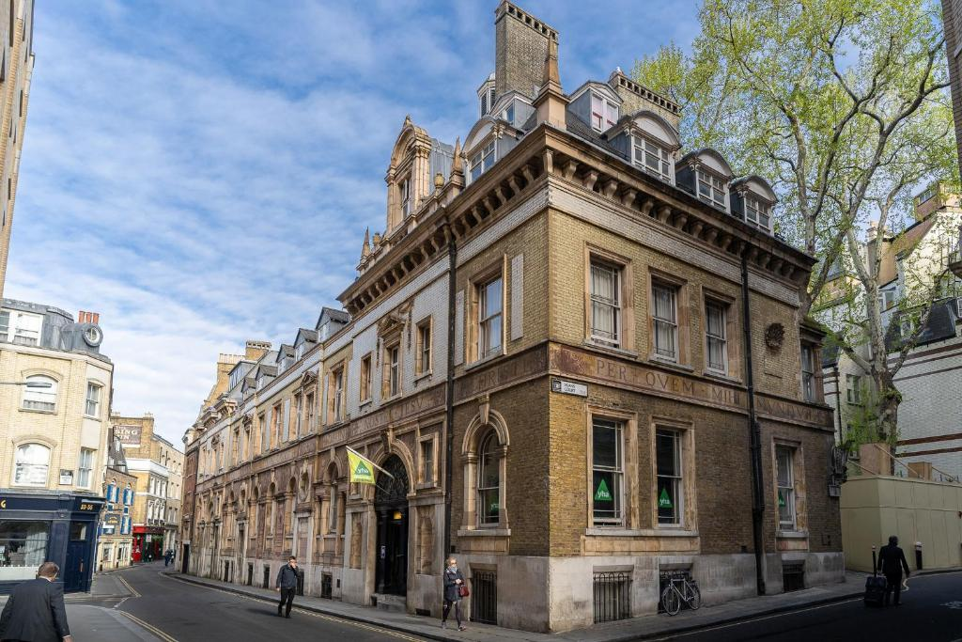
Arrival- 12:15 Drop off bags at St Paul’s

Slide 10
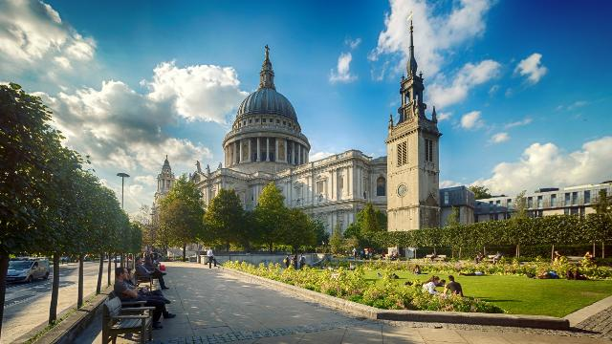
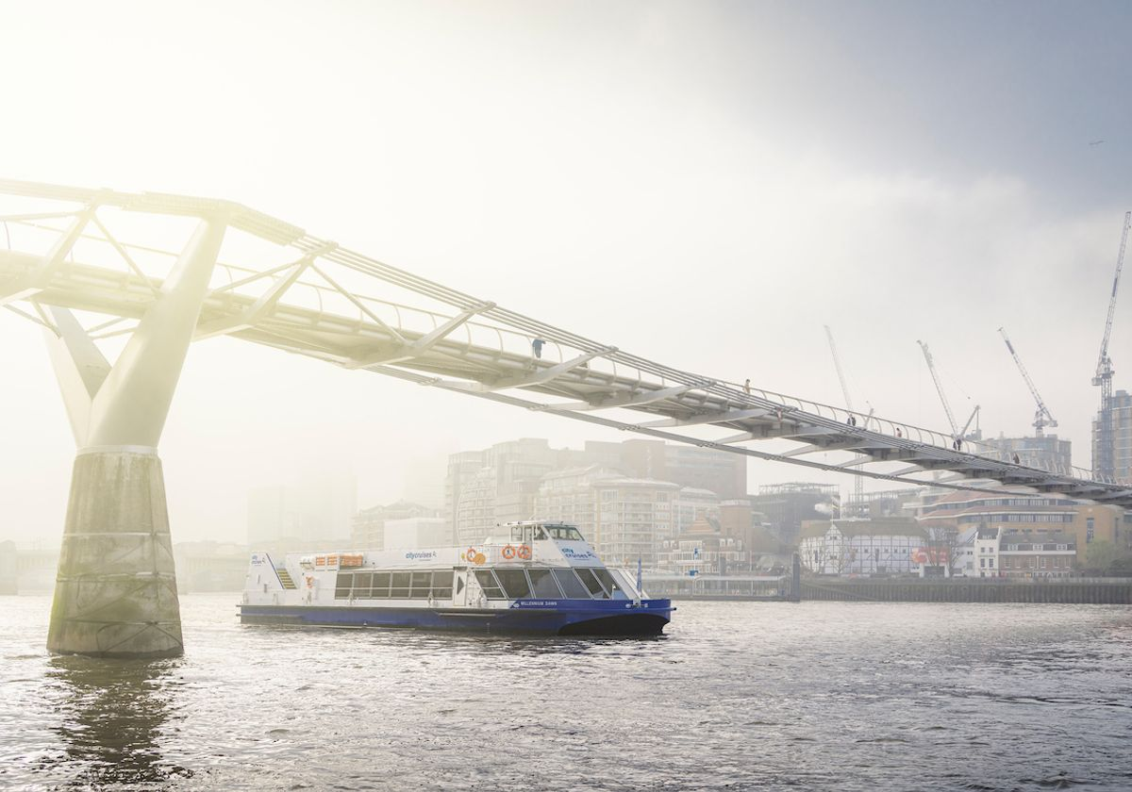
1:30pm Lunch
Afternoon - River Cruise
Children will eat their packed lunch.
Walk to Tower Bridge
River Cruise on the Thames from Westminster Bridge

Slide 11
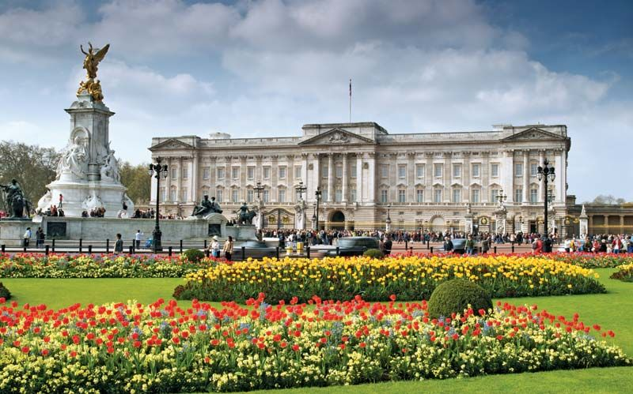
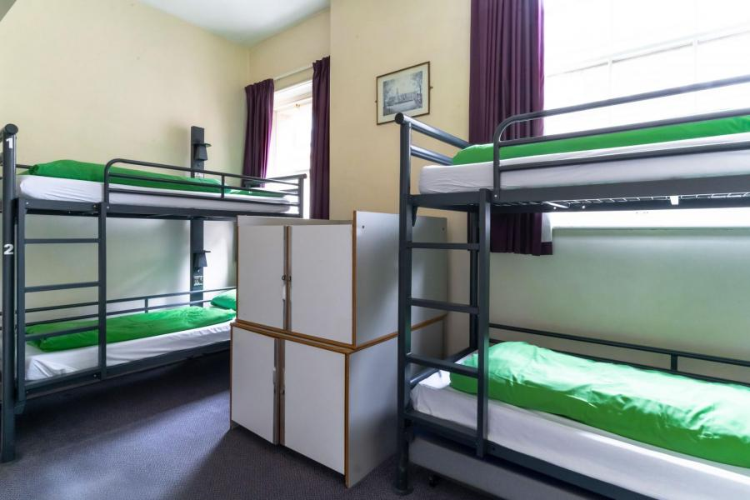
5:00pm- Check in to St Paul’s YH 7:00pm – Pre-booked evening meal
Walk to Buckingham Palace and Covent Garden to see the performers
10pm – Lights out

Slide 12
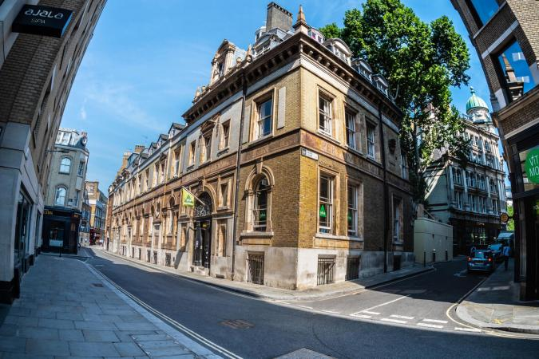
Day 2 – Tuesday

Slide 13
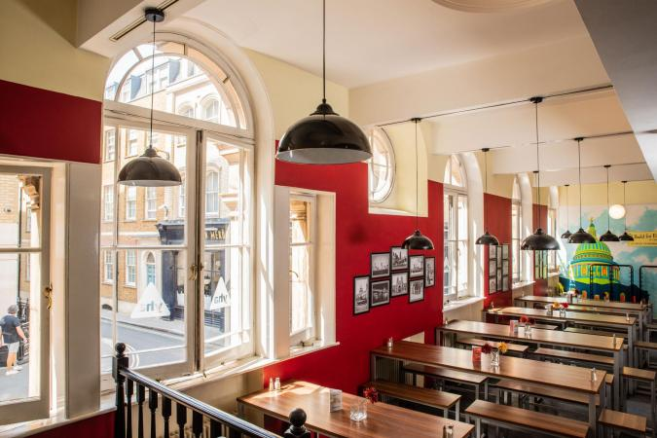
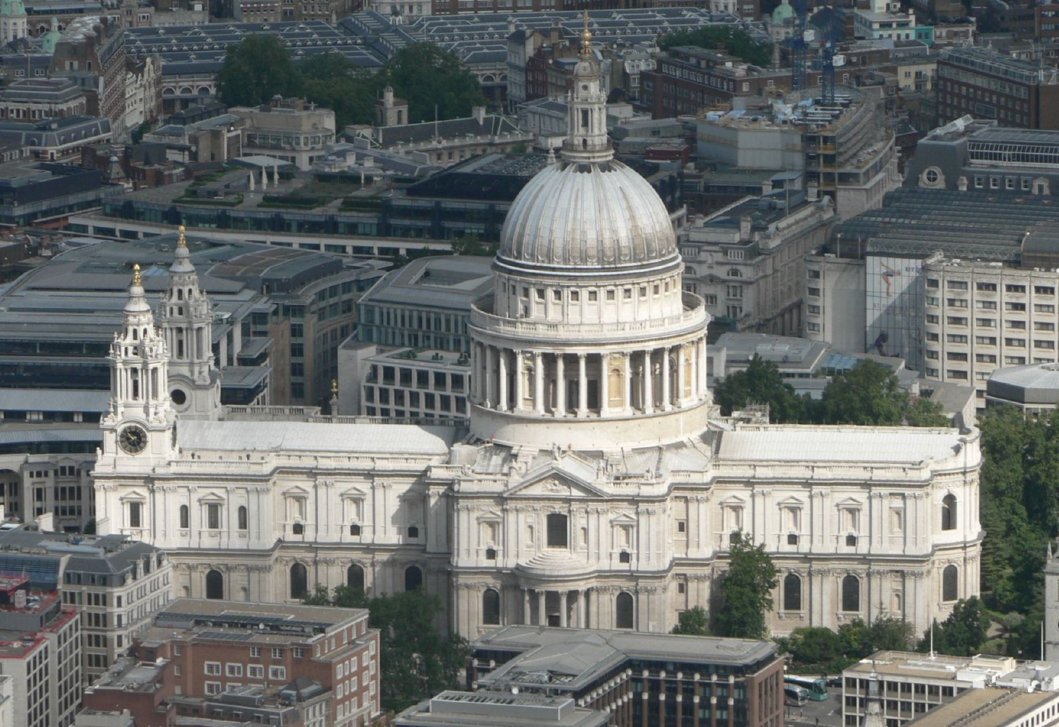
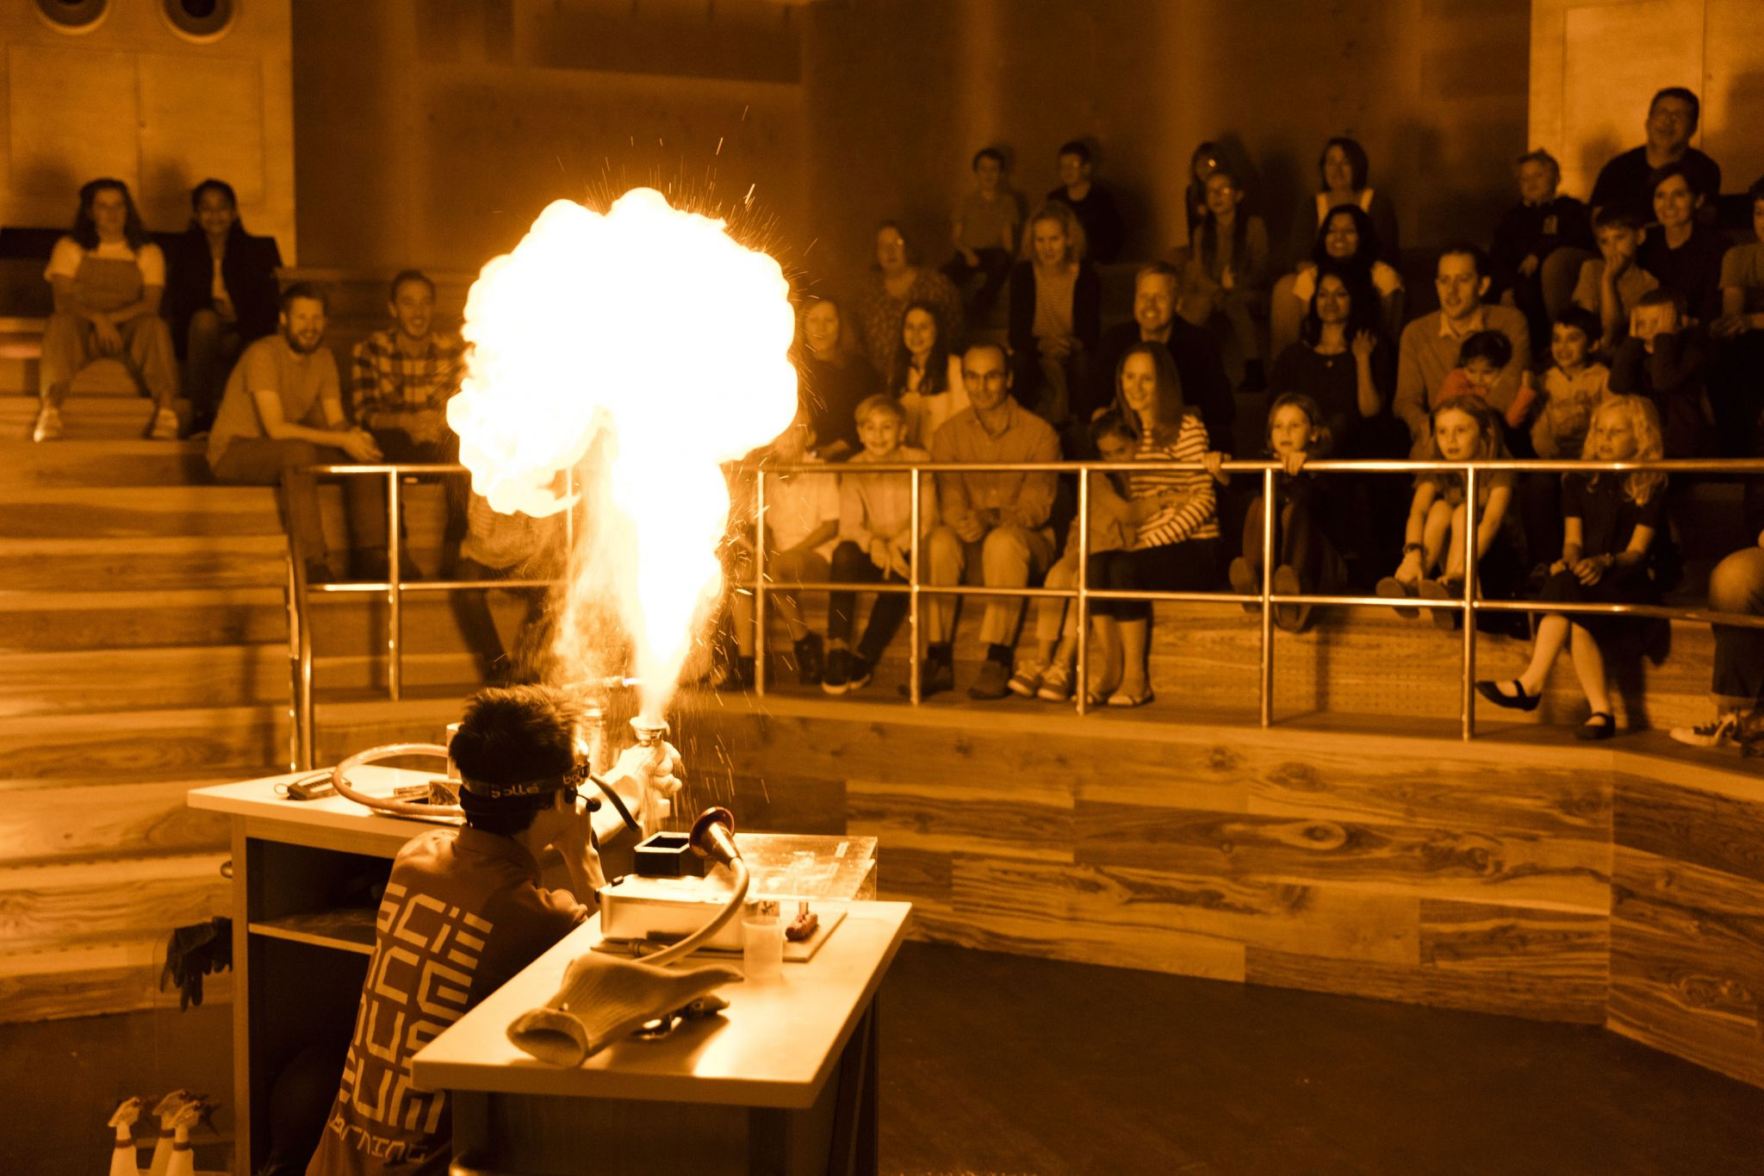
7:30am – Up and dressed 8:00am – Breakfast in the hostel Given pre-selected packed lunch
9:00am Visit to St Paul’s Cathedral Shopping for mementos Science Museum 3:15pm ‘Flash Bang Wallop’ Experiment Show

Slide 14
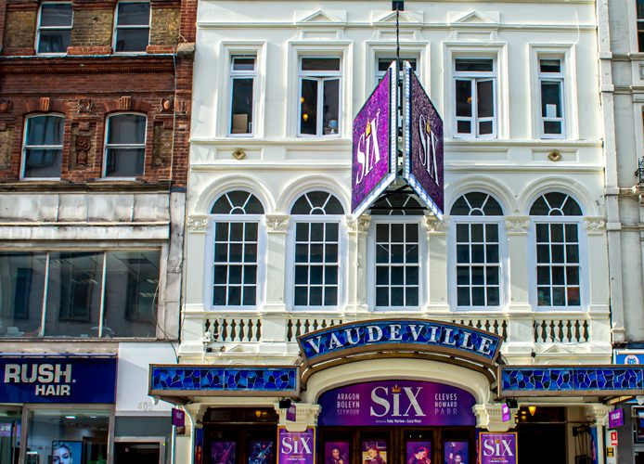
8pm SIX: The Musical
Back to the hostel, ready for bed and lights out
Back to the hostel 5:30pm Pre-selected evening meal Set off for Vaudeville Theatre 7:30pmToilet and seated We are all sat together

Slide 15
Day 3 - Wednesday

Slide 16
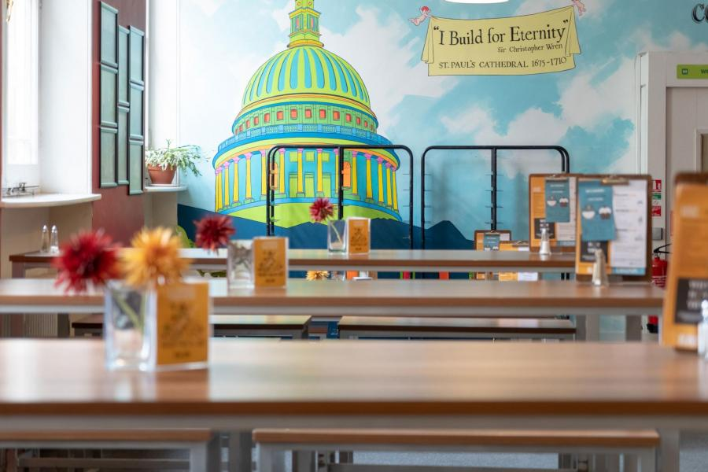
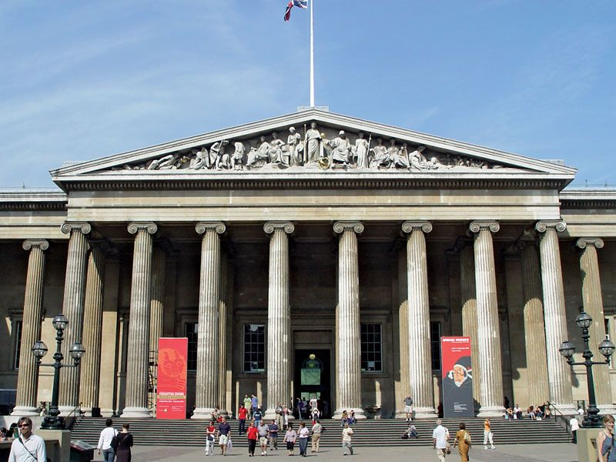
9:30am Walk to British Museum and put luggage in lockers – no wheeled cases or large items
7:30am Up, shower, dressed and packed
8:30am Breakfast Collect pre-selected packed lunch

Slide 17
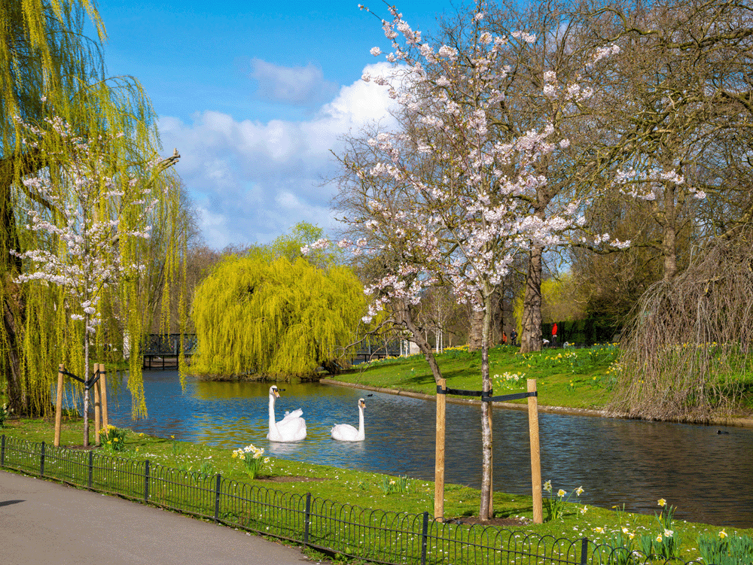
1:00pm – Eat lunch at the British Museum Visit Regent’s Park

Slide 18
Slide 27
3:30pm- 5:56pm Train from Euston to Lancaster
Parents collect children from Lancaster Train Station Children will be sat in pairs on carriage.
Can play cards/ read a book
Can have a snack and drink

Slide 19
Slide 27
Thursday – Children due into school for 10:30am

